Slide 1


Predicting PCOS Diagnosis Using SVM and Exploratory Analysis
Janica St Ville & Jeff Hackmeister
ALY 6015 – Final Project
May 2025

Slide 2
Project Overview
• Goal: Identify predictors of PCOS using real-world health data
• Dataset: 3,000 records based on Rotterdam criteria from Kaggle
• Focus: Early detection and improving treatment targeting
• Techniques used: EDA, SVM classification, and correlation analysis

Slide 3
Key Variables in the Dataset
• Age – Patient’s age
• BMI – Body Mass Index
• Menstrual Irregularity – Yes/No indicator
• Testosterone Level – ng/dL
• Antral Follicle Count – follicle count value
• PCOS Diagnosis – 0 (No) or 1 (Yes)

Slide 4

Data Preparation & Cleaning
• Minimal missing data – no imputation needed
• Renamed columns for clarity (e.g., T_Level, AC_Count)
• Converted binary integers to Yes/No factors
• Validated data structure and types

Slide 5
Exploratory Data Analysis (EDA)
• Used histograms, bar plots, and violin plots for variable distribution
• Antral Follicle Count and Testosterone Level showed strong separation between diagnosed vs. non-diagnosed
• Age and BMI showed weaker trends

Slide 6
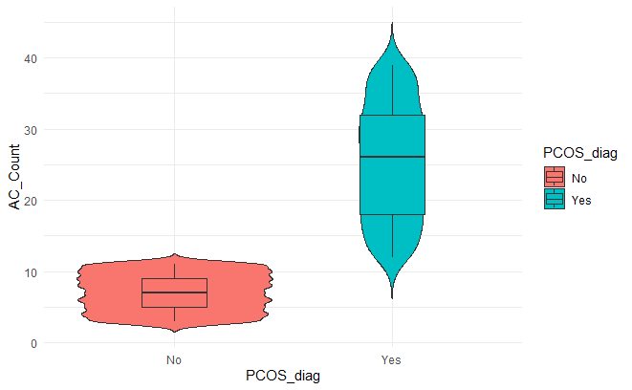
AC Count by PCOS Diagnosis

Slide 7
Correlation Matrix Insights
• Strong correlations observed between:
• AC Count and PCOS diagnosis
• Testosterone Level and PCOS diagnosis
• Weak correlation from Age and BMI
• Helped guide model input selection

Slide 8
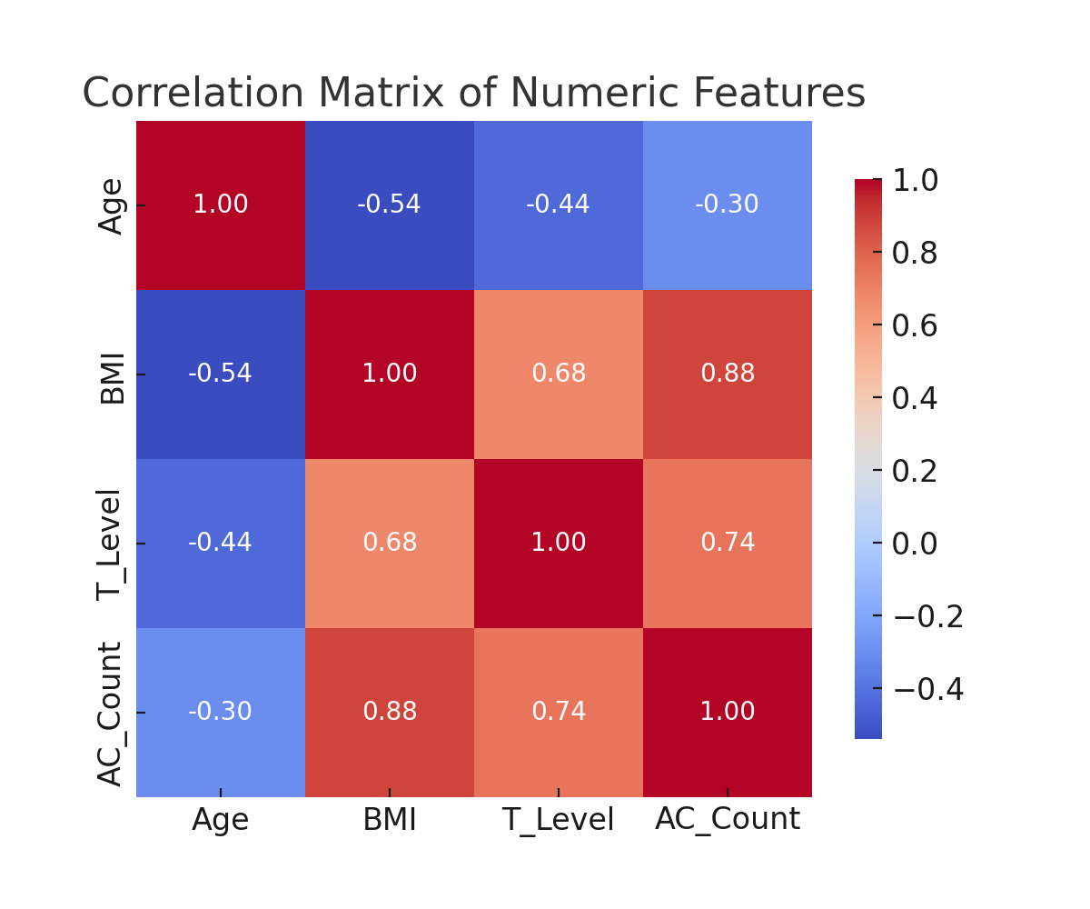
Correlation Matrix of Numeric Features
Notes:
This correlation matrix shows the relationships between numeric variables in the dataset. We can clearly see that Antral Follicle Count and Testosterone Level have strong positive correlation with each other and with the target variable PCOS diagnosis. Age and BMI appear to have weaker or no direct correlation.

Slide 9
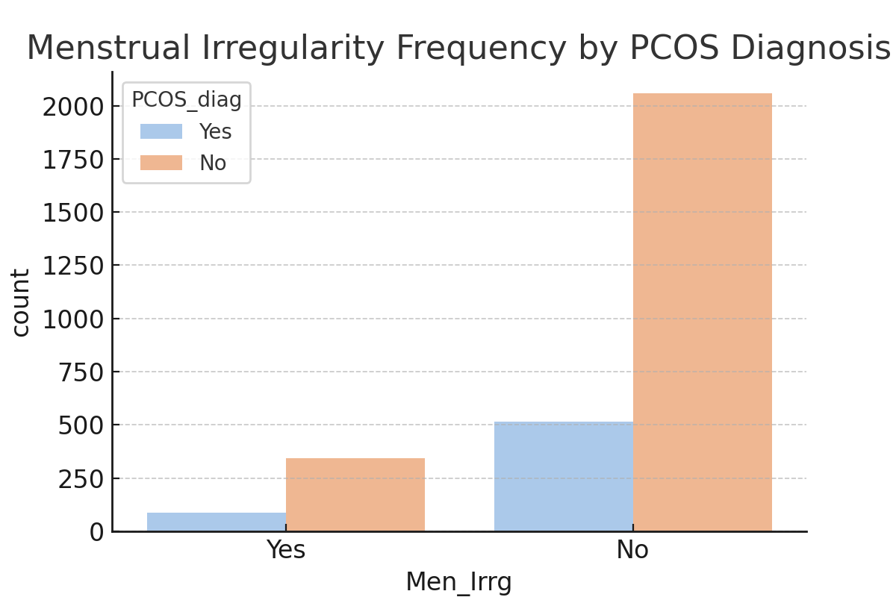
Menstrual Irregularity by PCOS Diagnosis

Slide 10
Support Vector Machine (SVM) Model
• Selected for flexibility and non-linear boundary support
• SVM trained on all variables
• Accuracy on entire dataset: 99.9% (3 errors total)
• Support Vectors identified: 64

Slide 11
Train/Test Model Performance
• Train/test split: 70/30
• Accuracy: 99.67% | Kappa: 0.9896
• Sensitivity: 99.86%, Specificity: 98.89%
• Only 3 total misclassifications (1 false positive, 2 false negatives)

Slide 12
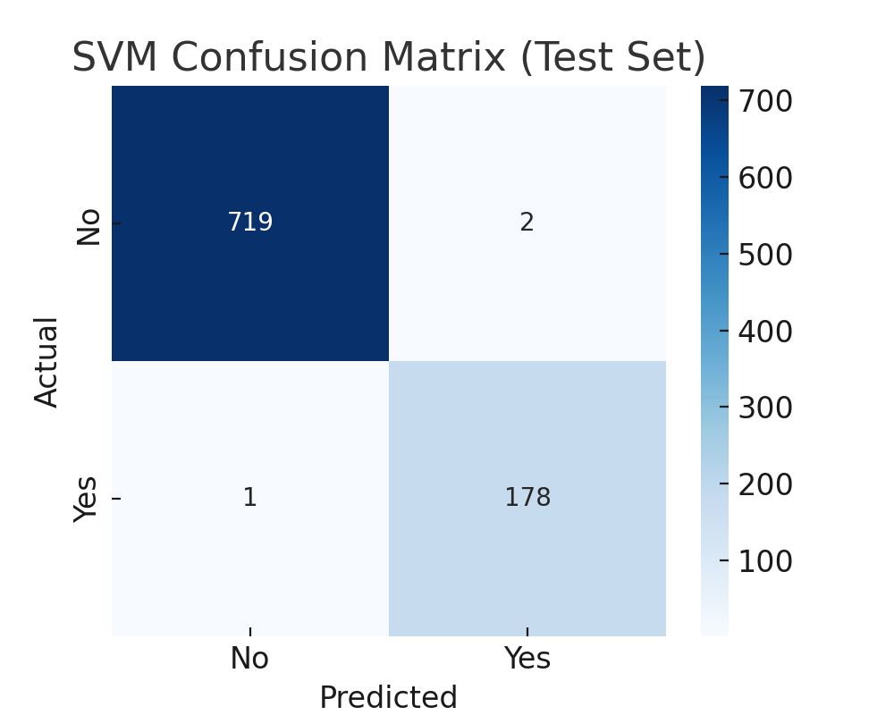
SVM Confusion Matrix (Test Set)
Notes:
Here we display the performance of our SVM model on the 30% test set. The confusion matrix reveals that only 3 predictions were incorrect—2 false negatives and 1 false positive—leading to a final model accuracy of 99.67%. This confirms the strength and reliability of the SVM classifier.

Slide 13
MDS and GGPairs Visualizations
• Used Multidimensional Scaling (MDS) to view distance between observations
• Support vectors plotted with distinct markers
• GGPairs plots showed strong visual separation with AC Count and T_Level
• Age showed limited contribution

Slide 14
Key Takeaways and Insights
• AC Count is the strongest predictor
• T_Level and Menstrual Irregularity also reliable
• Age and BMI contribute less to diagnosis prediction
• Visualizations support the model’s findings

Slide 15
Recommendations & Next Steps
• Validate the model with external datasets
• Incorporate demographic and socioeconomic variables
• Compare SVM with Random Forest and Logistic Regression
• Use model to support early clinical screening

Slide 16

Conclusion
• SVM model shows high accuracy and clinical relevance
• Visual and statistical analysis support findings
• Potential to improve early diagnosis and reduce underdiagnosis of PCOS
• Future work needed to generalize and expand the model

Slide 17
References
https://www.rdocumentation.org/packages/arules/versions/1.6-4
• Christ, J. P., & Cedars, M. I. (2023). Current Guidelines for Diagnosing PCOS. Diagnostics, 13(6), 1113.
• https://doi.org/10.3390/diagnostics13061113
• Classifying Data Using SVMs in R. (2018, August 28). GeeksforGeeks.
• https://www.geeksforgeeks.org/classifying-data-using-support-vector-machinessvms-in-r/
• cmdscale function - RDocumentation. https://www.rdocumentation.org/packages/stats/versions/3.6.2/topics/cmdscale
• e1071 package - RDocumentation. (2024). https://www.rdocumentation.org/packages/e1071/versions/1.7-16
• Soares, L. S. (2025). Polycystic Ovary Syndrome PCOS. Kaggle. https://www.kaggle.com/datasets/lucass0s0/polycystic-ovary-syndrome-pcos/data
• World Health Organization. (2025). Polycystic Ovary Syndrome Fact Sheet.
• https://www.who.int/news-room/fact-sheets/detail/polycystic-ovary-syndrome

